Slide 1
Online Courses Application
By: Mukul Tripathi

Slide 2
Tools used
JDK 1.8
MySql (DB server and Workbench)
Spring STS (Eclipse based IDE)
Cmder
GitHub
Notepad++

Slide 3
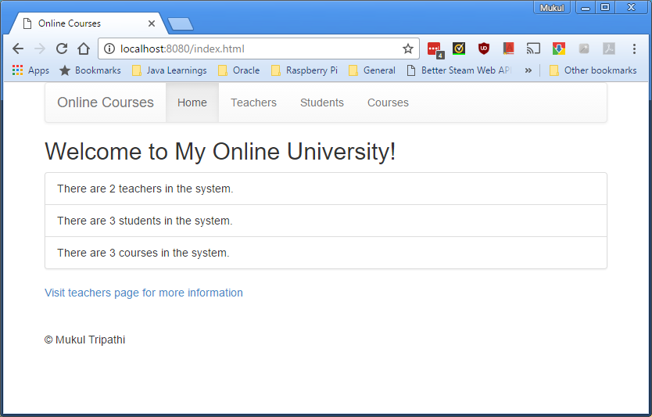
Demo of the end product : Home Page

Slide 4
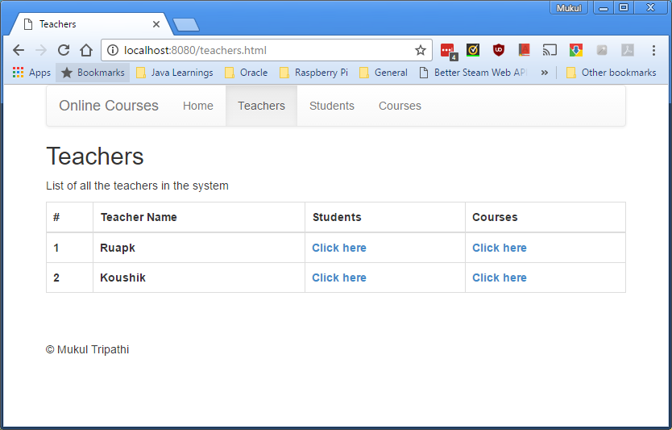
Demo of the end product : Teacher Page

Slide 5
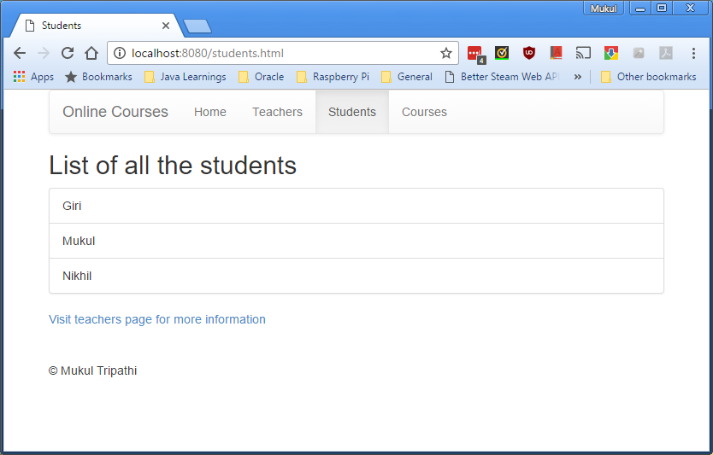
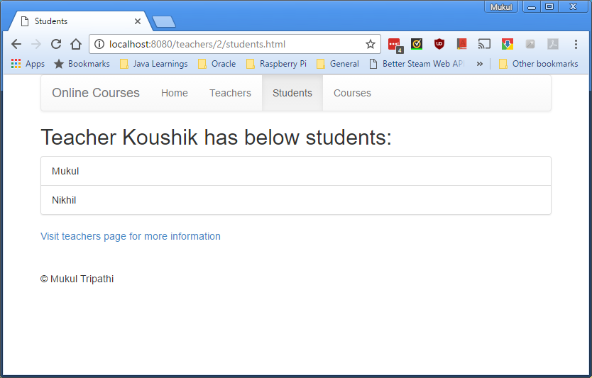
Demo of the end product : Student Page

Slide 6
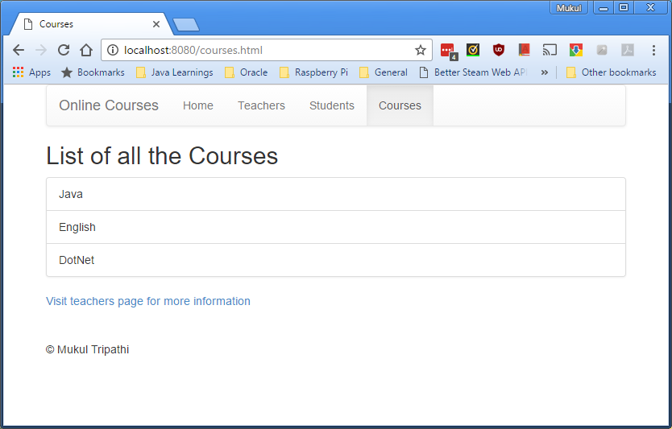
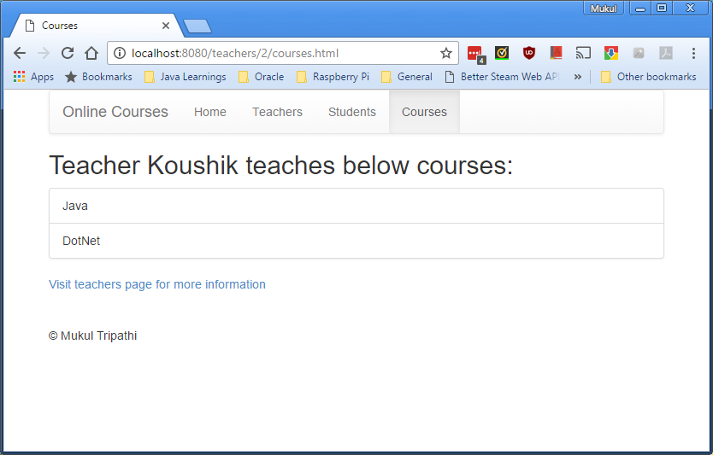
Demo of the end product : Course Page

Slide 7
Technologies used
Java 1.8
MySQL
Maven as dependency manager and build tool
Spring 4.x
Spring MVC
Spring Data JPA
Hibernate as ORM implementation for JPA
Apache tiles and JSTL for view
Jetty as a development server

Slide 8
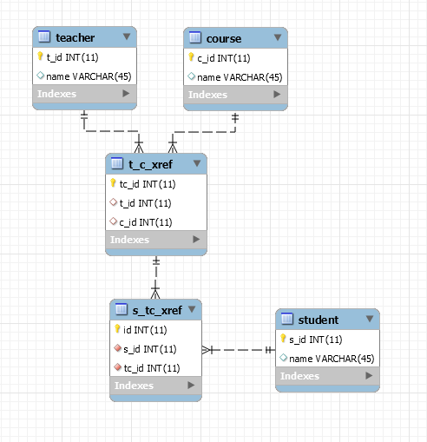
Enhanced Entity relationship diagram of DB
SQL for creating the DB schema, tables and load data

Slide 9
Relevant Queries to obtain data
To get list of all students for a given teacher
SELECT * FROM student s JOIN s_tc_xref stc ON s.s_id = stc.s_id JOIN t_c_xref tc ON stc.tc_id = tc.tc_id WHERE tc.t_id = ?;
To get list of all courses for a given teacher
SELECT * FROM course c JOIN t_c_xref tc ON c.c_id = tc.c_id WHERE tc.t_id = ?;

Slide 10
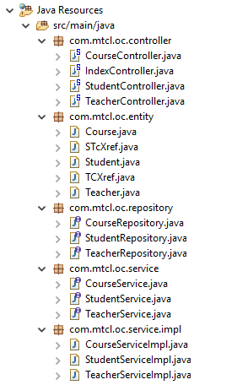
Java Source files and package structure
Controller Layer
Entity Layer
Repository Layer
Service Layer

Slide 11
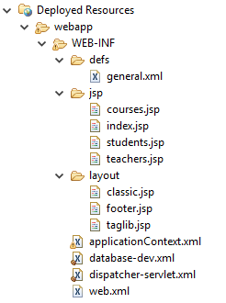
Deployed Resources
Tiles definition file
Jsp folder holding all views
Layout folder for tiles
Spring Application Context
Database connections file
Deployment descriptor
Spring dispatcher servlet acting as front controller

